Slide 1
CSC741 Digital Image Processing Assignment 7
Jessica Gallo & Alex Liew

Slide 2
Assignment
Jessica
Develop a tool to decompose an image into bit plane. Use the AND operator between slices and display your results
Develop a tool to filter noisy images using bit plane decomposition
Develop a tool to encrypt images using bit plane decomposition
In this task you need to load an image file into Matlab and slice it bitwise into 8 planes, then try to compress it by eliminating the unnecessary bits to reduce the whole image size. Practically you need to implement a code that compresses an image using bit plane decomposition
Alex
Develop a moving object detection method using bit plane slicing

Slide 3
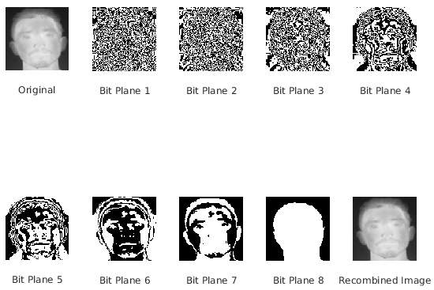
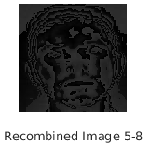

Apply bit-plane Slicing
Combined Images with certain bit planes

Slide 4
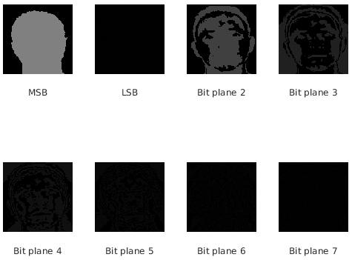
Decompose an image into bit plane using AND operator

Slide 5
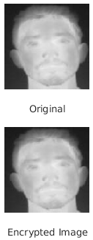
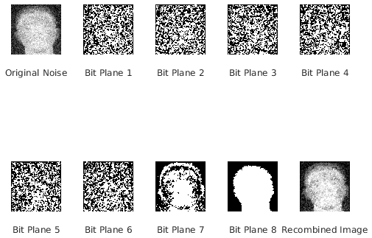
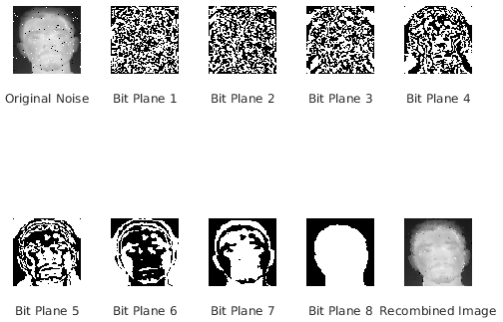


Filter noisy images using bit plane decomposition
Added mean filter to each bit plane
Gaussian
Better than original noisy image
Salt &
Pepper

Slide 6
Encrypt/Decrypt images using bit plane decomposition
LSB Based Image Steganography
Retrieved LSB of pixel to get bit sequence of message
Message = Hello World!

Slide 7
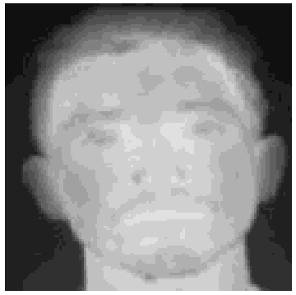








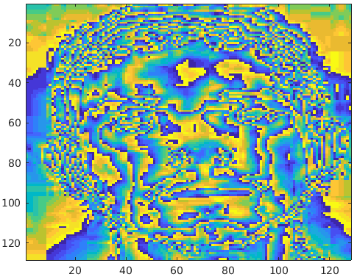
Compress an Image Using Bit Plane Decomposition To reduce Image Size
Bitwise Separation
Eliminated least significant 4 bits (half storage size)
Difference between the 2 Images (smallest value = purple/blue; largest value = yellow)

